Slide 1

Managing Stakeholder Feedback: Lessons from Experience August 2022
Stephanie M. Morrison, MPH
Writer-Editor
Office of Communications and Public Liaison
National Institute on Aging
National Institutes of Health

Slide 2
Pros and cons of stakeholder feedback
Helpful feedback can…
Ensure consistency with agency policy and style Validate accuracy and currency Identify missing information Improve clarity and focus Provide credibility Build relationships Identify issues early
But suggestions may…
Take time to request and incorporate Require follow-up Be out of scope Use jargon or technical language Contradict one another Need tools to manage
Stakeholders include anyone who reviews your materials and has a say in its style or content.

Slide 3


Success factors
Practical
Effective copy
Plain writing
Version control
Interpersonal
Relationship-building
Clear communication
Diplomacy
Notes:
Images: Microsoft PowerPoint stock images

Slide 4


Types of reviewers: Gatekeepers and SMEs
Gatekeepers
Supervisor
Agency leaders
Office of Comms.
Legal department
Subject matter experts
Analysts Researchers
Scientists
Lawyers
Ensure appropriateness and consistency with agency style and policy
Ensure accuracy, currency, and completeness of content
Notes:
Images: Microsoft PowerPoint stock images

Slide 5

Getting prepared
Choose the best stage to ask for input
List everyone who needs to review
Determine what feedback would be most helpful
Clarify the scope of the review
Consider your timeline and deadlines
Think about the best way to contact reviewers
Notes:
Image: Microsoft PowerPoint stock image

Slide 6

Making the request
Be clear about your needs
Create a brief and scannable message
Identify the target audience
Provide the right amount of context
Explain the editorial process
Estimate the time the review will take
Provide a deadline
Outline next steps
Notes:
Image: Microsoft PowerPoint stock image

Slide 7

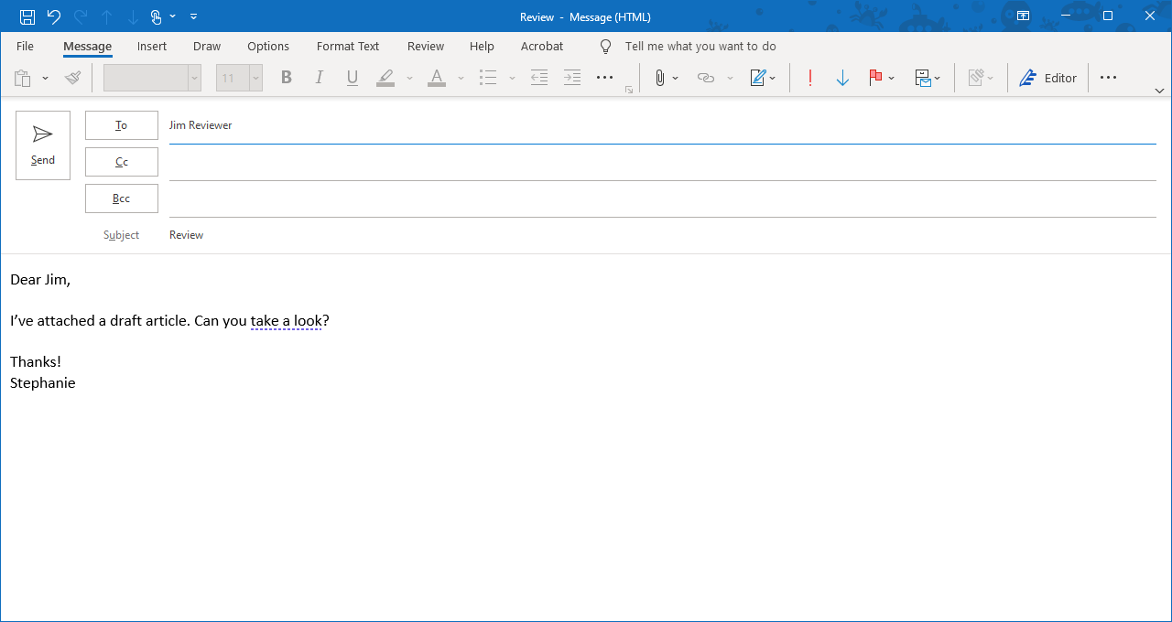
Example 1: Not enough information
Notes:
Image: Microsoft PowerPoint stock image

Slide 8

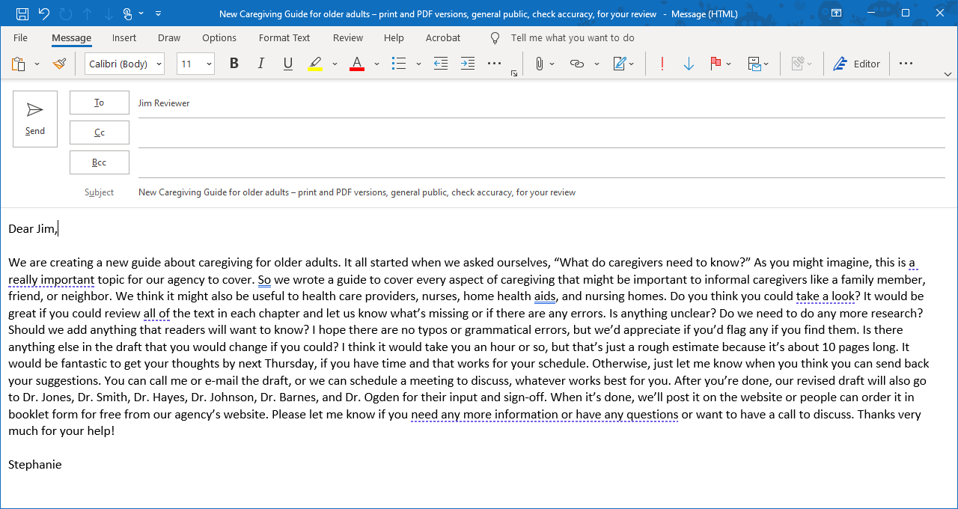
Example 2: Too much information
Notes:
Image: Microsoft PowerPoint stock image

Slide 9

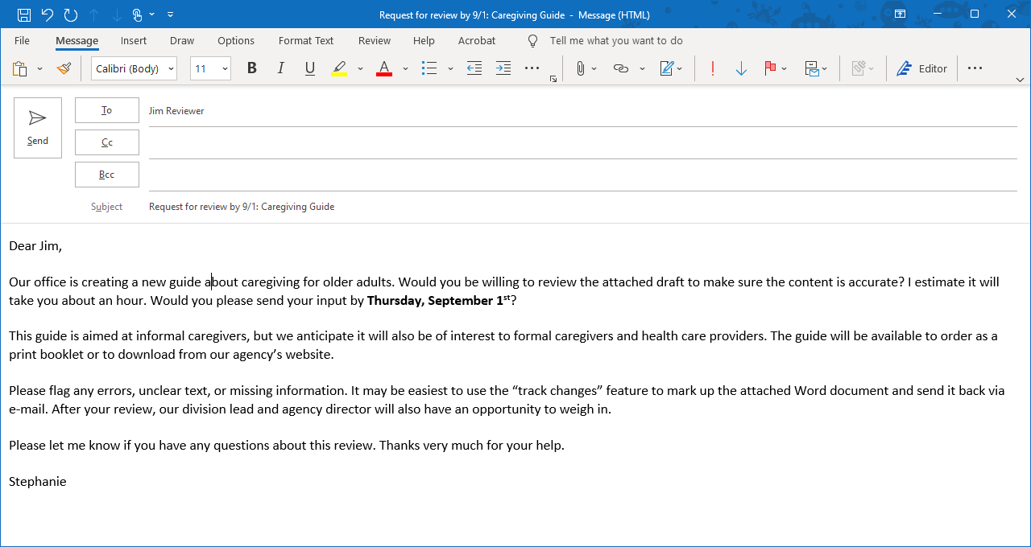
Example 3: The right amount of information
Notes:
Image: Microsoft PowerPoint stock image

Slide 10
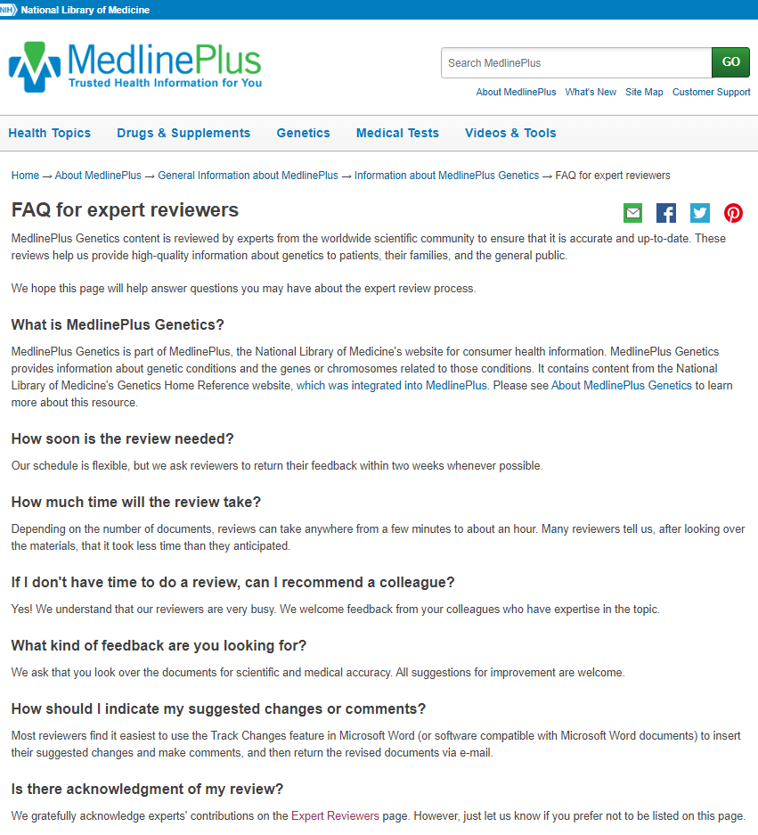

If you work with many reviewers, consider creating a set of instructions or an FAQ
https://medlineplus.gov/about/general/genetics/expertreviewersfaq/
Notes:
Image: Microsoft PowerPoint stock image

Slide 11

Following up
Gatekeepers
Remind them why the materials are a priority (e.g., audience)
Negotiate a deadline
Try meeting instead of e-mailing
Call on a supervisor or other leader to step in
Subject matter experts
Tell them when you’ll follow up
Consider how many attempts to make
Ask whether there’s someone else they can recommend
After a grace period, look for another reviewer
Notes:
Image: Microsoft PowerPoint stock image

Slide 12
What to do about jargon and technical language
Some reviewers will be better than others at explaining things plainly.
Thank every reviewer for his or her time and suggestions.
Use this as an opportunity to demonstrate the value of using plain language!
Ask yourself:
Is the change critical? Could you leave the wording as-is or remove it?
Could you rework the text without using their exact phrasing?
Are you confident your plain-language rewrite is still accurate?

Slide 13

I disagree with a reviewer’s edit…now what?
Don’t get defensive or take the feedback personally.
Approach it as a conversation, not a debate:
Ask the reviewer to explain their rationale.
Explain your concerns or constraints.
Share your thought process.
Be open to changing your mind.
Make it clear that the reviewer’s input was valued, even if you didn’t take every suggestion.
Notes:
Image: Microsoft PowerPoint stock image

Slide 14

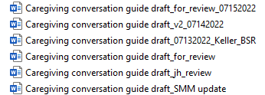
Juggling feedback from multiple reviewers
Reviewers may make different suggestions for the same text or even contradict one another.
Save different versions of the draft with informative file names.
Ask yourself:
Which suggestion is most helpful?
Can I work in elements of both reviewers’ edits?
Do I need to make the edits of the highest-ranking reviewer?

Slide 15
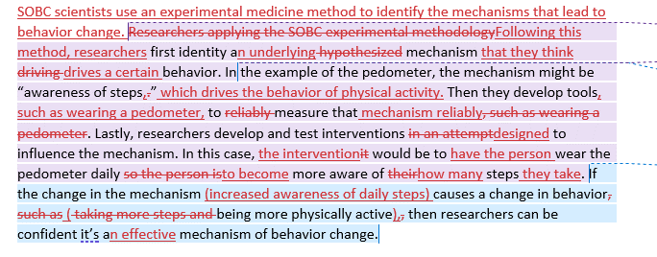
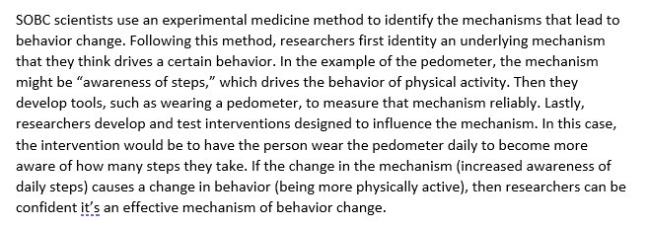
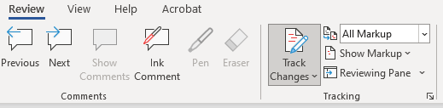
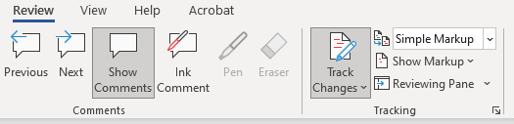
Simple Markup for Tracked Changes
“Simple Markup” can make heavily edited text easier to read.

Slide 16
Tips for managing reviewers
Make it easy for the reviewer. Give them the information they will need up-front and answer their questions.
Be clear about your editorial process. This can help avoid misunderstandings later.
Have a reasonable timeline. Make sure everyone knows what it is and follow up when you say you will.
Build relationships. Ask if you can approach a good reviewer again in the future and keep a list with contact information.
Always be grateful for feedback. Even suggestions you can’t use were given in good faith. “All feedback is a gift.”

Slide 17

How to be a better reviewer
Questions to ask the author:
Who is the target audience?
What is your editorial process?
Which areas would you like me to focus on?
What kind of feedback would be most helpful?
What format should I use to send suggestions?
When do you need this from me?
Notes:
Image: Microsoft PowerPoint stock image

Slide 18

How to be a better reviewer, continued
When giving feedback:
Explain your rationale for recommending certain changes
Understand that the person may not take all of your suggestions
Make sure your feedback is respectful and constructive
Meet the agreed-upon deadline…don’t make the writer chase you down!
Notes:
Image: Microsoft PowerPoint stock image

Slide 19
Questions?
Questions?
Stephanie.Morrison@nih.gov

